Slide 1
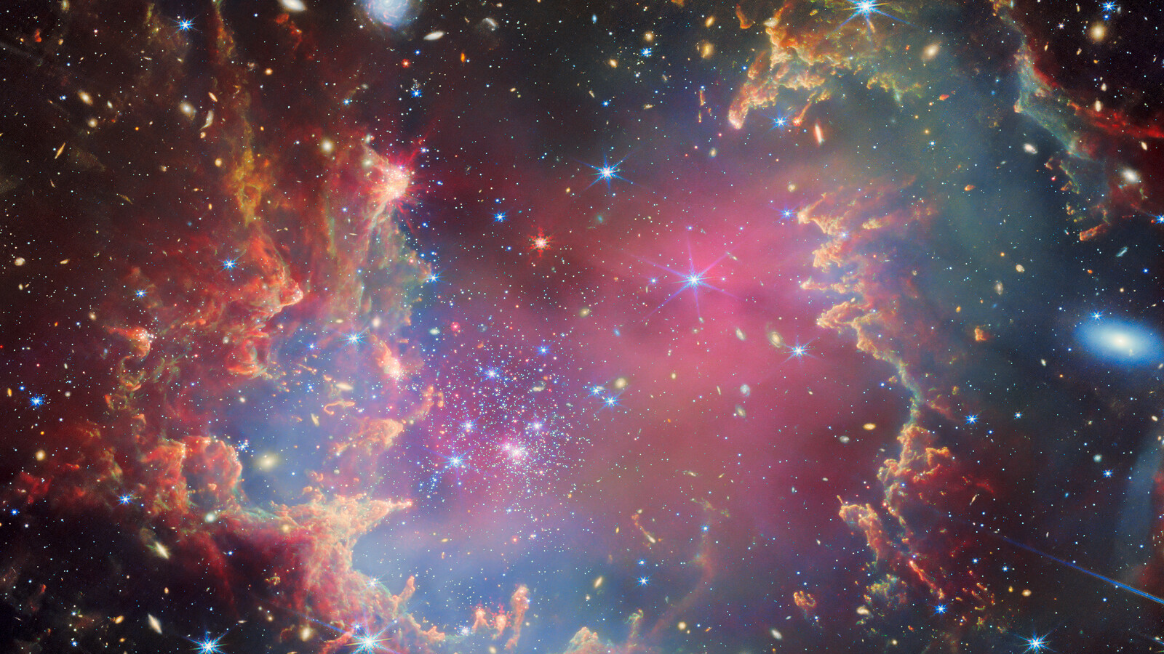
Predicting Earth-Like Similarity in Exoplanets Using Machine Learning BY: Samia Mahmood

Slide 2
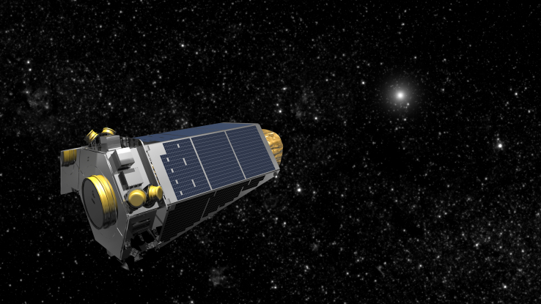
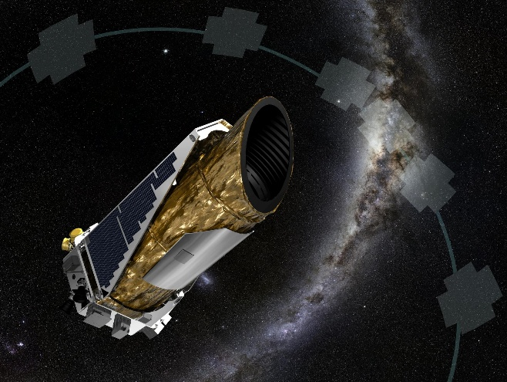
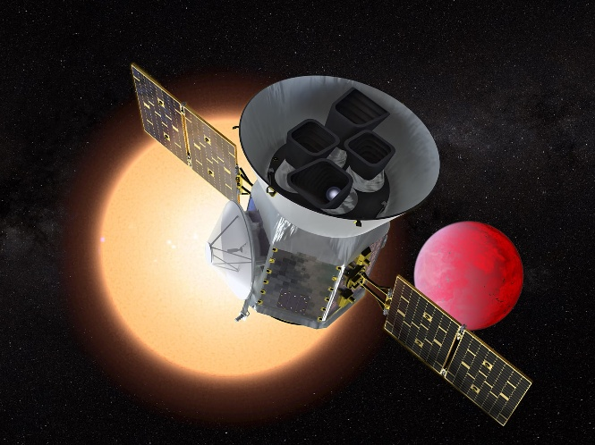
Introduction
Kepler
Data from NASA’s Exoplanet Archive
Over 6,071 confirmed exoplanets as of 2026
Discovered mainly by:
Kepler Telescope
K2 Telescope
TESS Telescopes
Discoveries revolutionized by advancements in missions and telescopes
K2
TESS

Slide 3
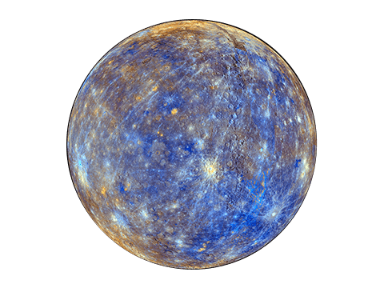
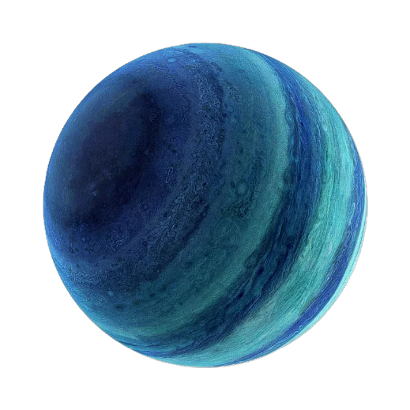
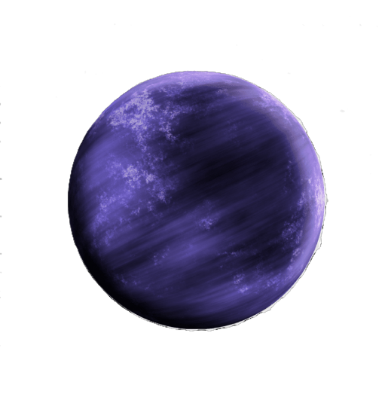
Motivation: Problem to solve
Rapid growth of exoplanet discoveries creates challenges in studying exoplanets
Manual analysis of astronomical dataset difficult:
Large-scale
High-dimensional → complex
Highly variable → outliers
Incomplete
Not uniformly distributed
Outpaced our ability to efficiently analyze, categorize, determine Earth-Like similarity, and assess habitability

Slide 4
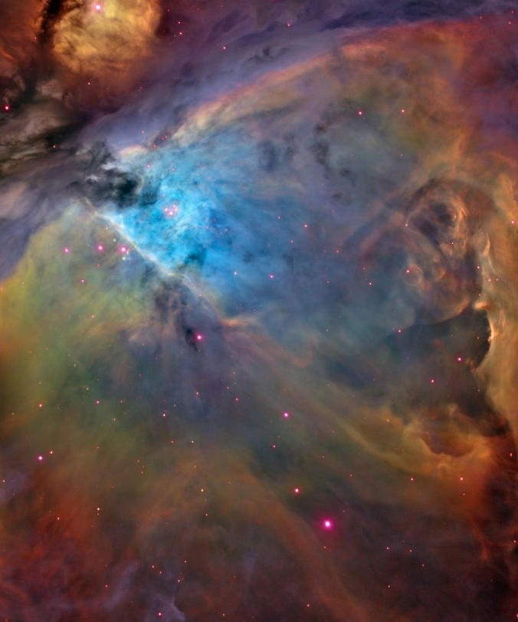
objective
Integrate a structured reproducible EDA with Supervised learning and Unsupervised learning models:
Predict Earth-Like Similarity
Exploratory Data Analysis (EDA):
Explore relationships between stellar and planetary features
Categorize exoplanets based on Mass and Radius
Supervised Learning (1 Model):
Identify top 10 Earth-Like exoplanets (Predefined target row Earth and Sun)
Evaluate their habitability potential
Unsupervised Learning (3 Models):
Determine natural planetary groupings (without predefined labels)

Slide 5
background

Slide 6
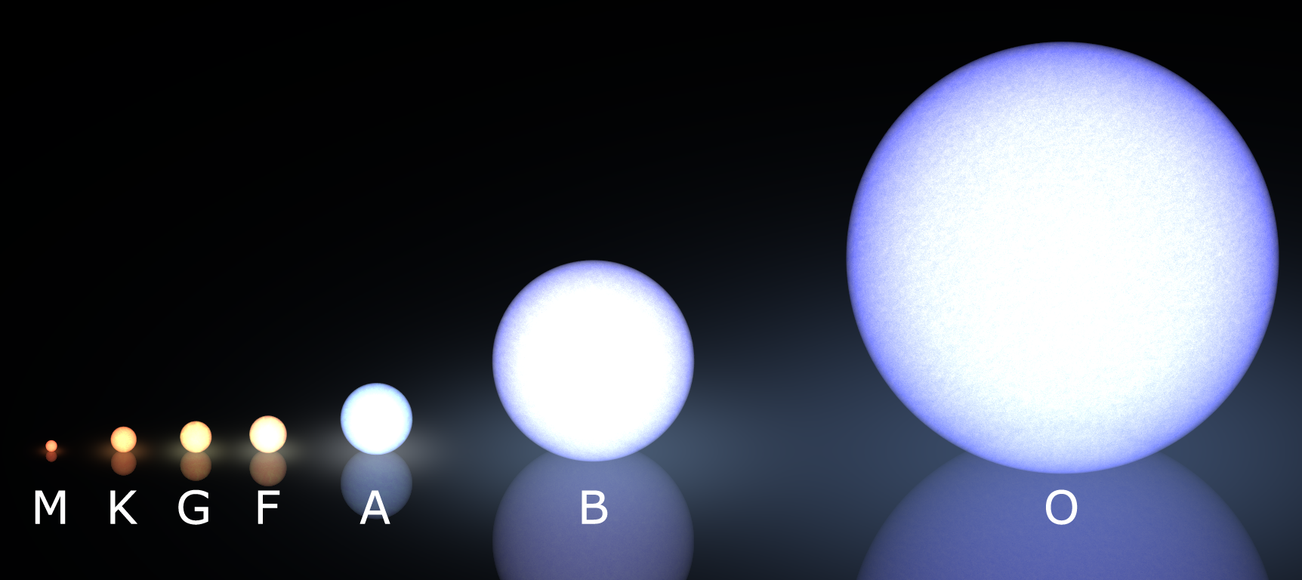
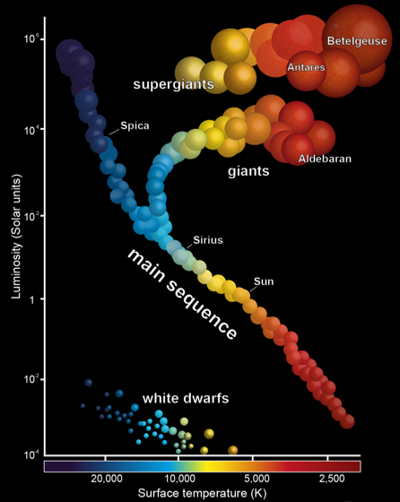
Background: Stellar criteria
Host stars are classified by their star types:
M (Red Dwarf), K, G (Sun-like), F, A, B, or O
In order of coldest to hottest
In order of most lifetime to least lifetime
In order of smallest to largest
Star types A, B, and O unlikely to host life due to short lifetimes
Higher energy → faster burn out
Star types M, K, G, and F are likely to sustain life due to longer lifetimes
Host stars are classified by their luminosity class:
Main Sequence (V), Sub-Giants (IV), Giants (III), Bright Giants (II), Super Giants (I), and White Dwarfs (WD)
More luminous → brighter → more energy emitted → more radiation

Slide 7
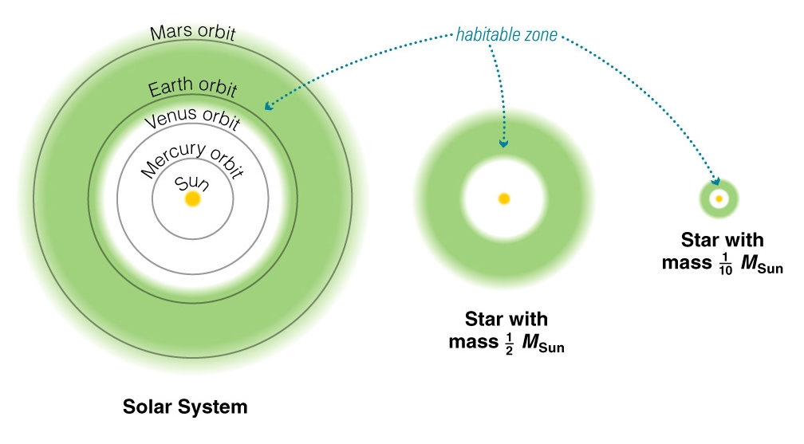
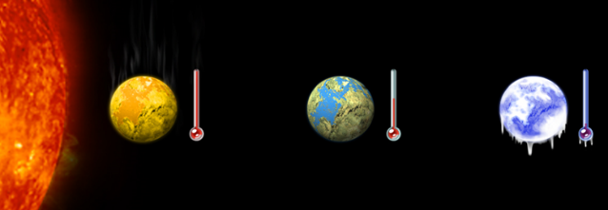
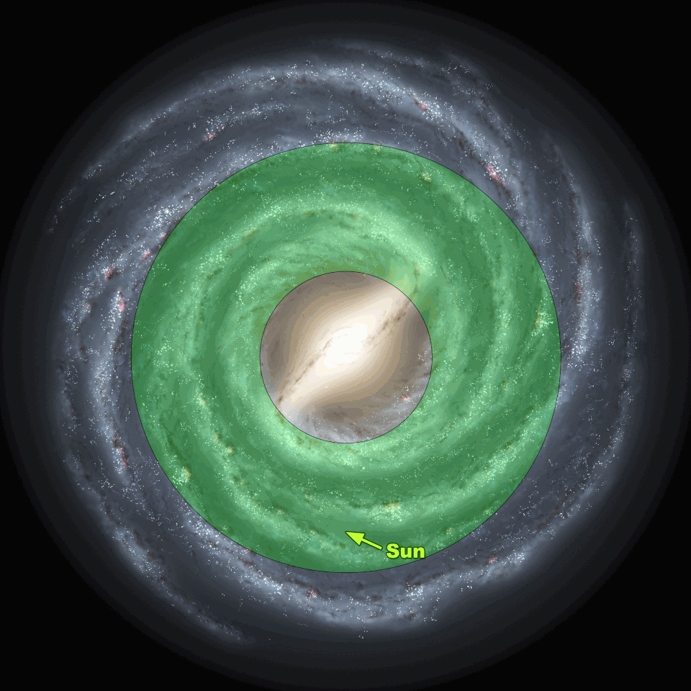
Background: habitability criteria
Star’s Habitable Zone (HZ):
Depends on the star type
Describes the optimal distance between the exoplanet and its host star → needed for liquid water → to allow habitability
Galactic Habitable Zone (GHZ):
Area within the Milky Way Galaxy with reduced radiation → to allow habitability

Slide 8
methodology

Slide 9

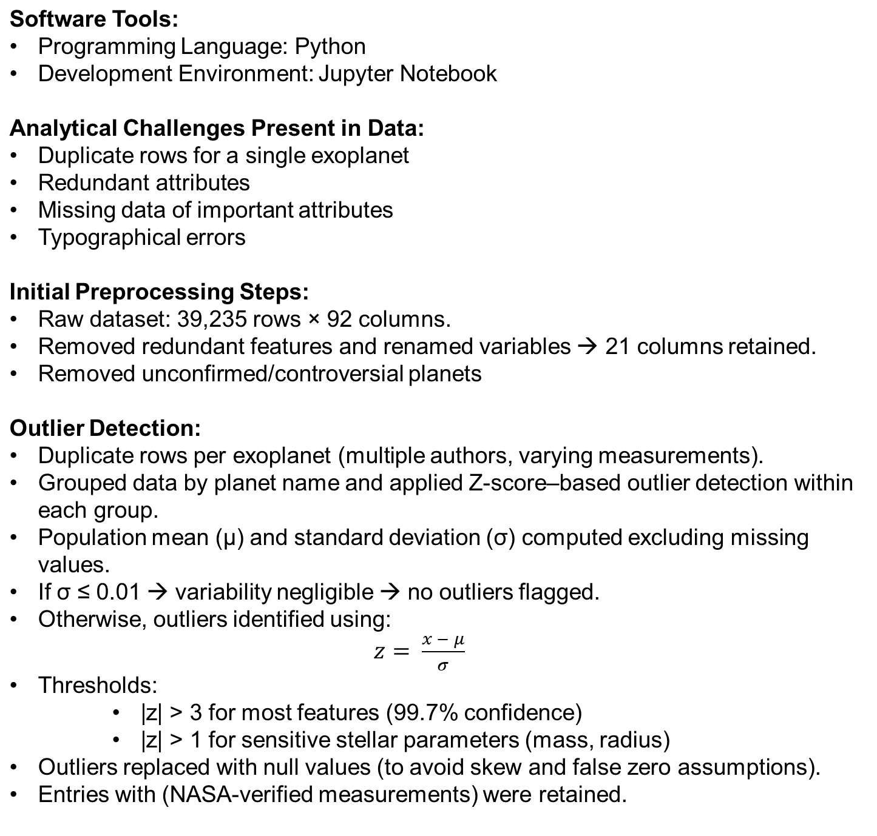
Methodology: Initial Data Cleaning

Slide 10

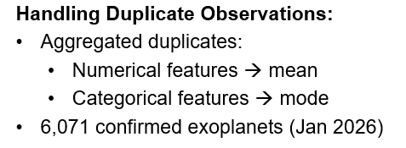
Methodology: Outliers & duplicate rows

Slide 11
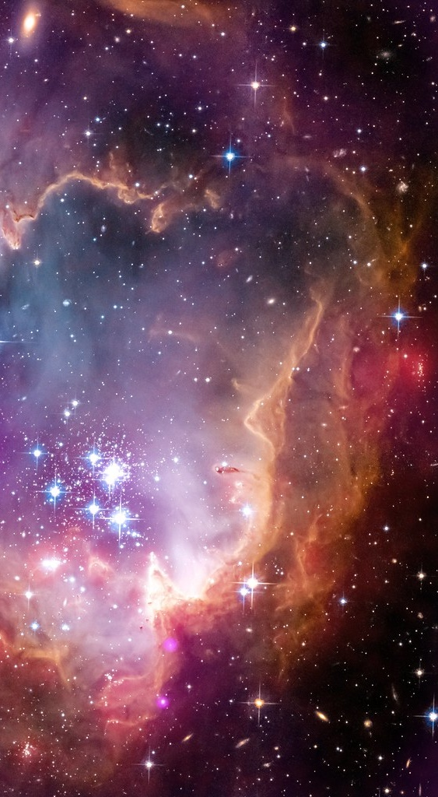
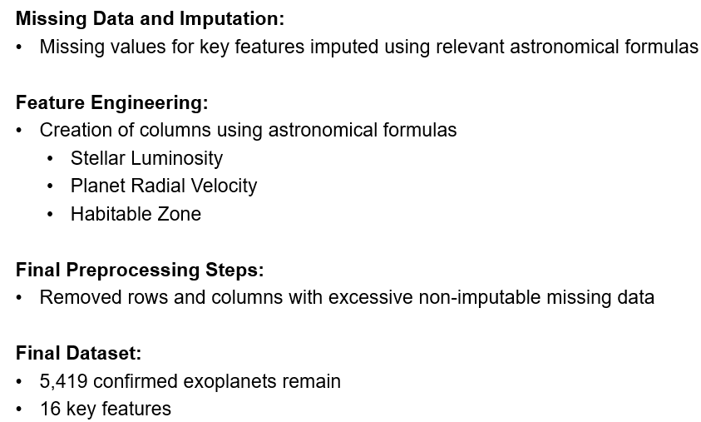
Methodology: Final Data Cleaning & dataset description
Variable Name
Planet Name
Star Number Per System
Orbital Period
Orbital Semi Major Axis
Planet Radius
Planet Mass
Planet Equilibrium Temperature
Spectral Type
Stellar Effective Temperature
Stellar Radius
Stellar Mass
Stellar Surface Gravity
Stellar Luminosity
Planetary Orbital Velocity
Habitable Zone

Slide 12
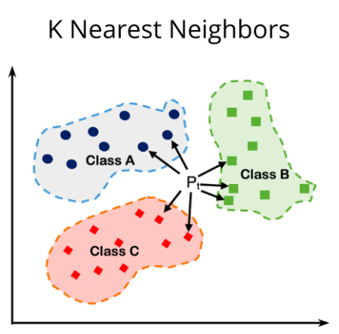
Methodology: K Nearest Neighbor (KNN) Model
Supervised Learning → Predefined target row corresponding to synthetic “Earth” reference point in feature space.
Used to compare all planetary and stellar features of all exoplanets to Earth and the Sun respectively.
Automatically produce a list of the top 10 Earth-Like exoplanets and insight into their habitability potential
Similarity measured via distance → smaller distance → closer to Earth in feature space → more Earth-Like
Data preprocessing:
One-hot encoding for categorical features
Feature normalization and scaling
Heavier weights applied to features important for determining Earth-Like similarity and habitability
Two KNN models using two distance metrics for robustness:
KNN Model #1 - Manhattan distance → considers similarity for all features combined
KNN Model #2 - Euclidean distance → sensitive to deviations between a feature

Slide 13
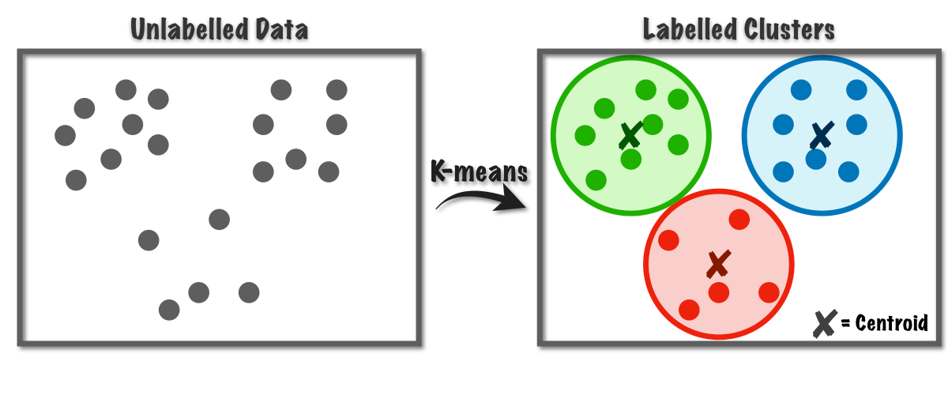
Methodology: K Means Clustering
Unsupervised learning → Identify natural groupings of exoplanets into their planetary systems without predefined labels.
Model applied to the top 10 Earth-like planets (from KNN Models #1 and #2) to determine their cluster membership (planetary system)
Partitions data into k clusters by minimizing within-cluster variance (focus on feature similarity)
Number of clusters: k = 4 clusters
Assumes clusters have spherical shape and all have same size
Reveals underlying structure in exoplanet populations
Data preprocessing:
One-hot encoding for categorical features
Feature normalization and scaling
Removed outlier planets
(planets with extreme anomalous values)

Slide 14
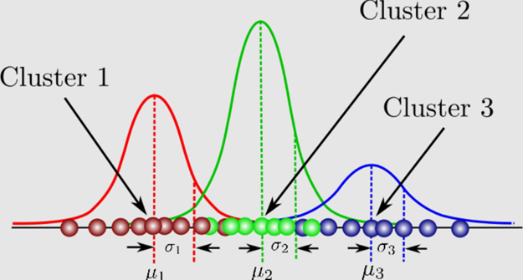
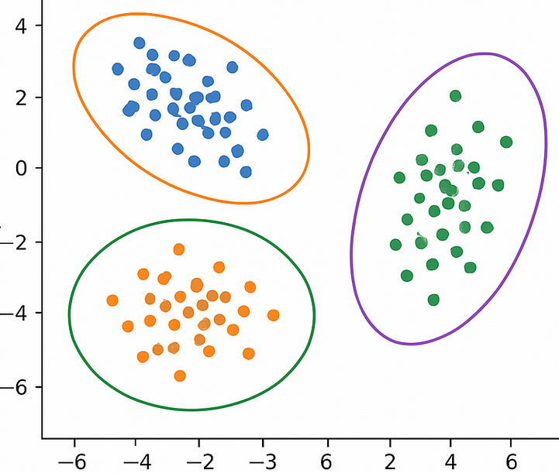
Methodology: Gaussian Mixture Model (GMM)
Unsupervised learning → Identify natural groupings of exoplanets into their planetary systems without predefined labels.
Model applied to the top 10 Earth-like planets (from KNN Models #1 and #2) to determine their cluster membership (planetary system)
Applied GMM clustering to capture more flexible, overlapping, and complex exoplanet groupings.
Does not assume spherical shape nor same sized clustered
Allows for elliptical shaped clusters
Partitions data into k number of distinct Gaussian distributions
Number of clusters: k = 4 clusters
GMM models probabilistic clusters (planetary systems)
Specific datapoint (exoplanet) has different probabilities of belonging to different planet
The cluster with the highest probably is the assigned cluster of data datapoint (exoplanet)
Assumes data is normally distributed
Data preprocessing:
One-hot encoding for categorical features
Feature normalization and scaling
Removed outlier planets (planets with extreme anomalous values)

Slide 15
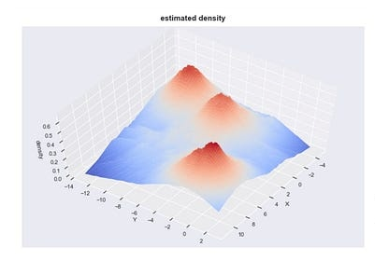
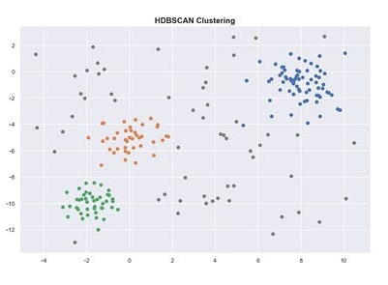
Methodology: Hierarchical Density-Based Spatial Clustering of Applications with Noise (HBDSCAN)
Unsupervised learning → Identify natural groupings of exoplanets into their planetary systems without predefined labels.
Model applied to the top 10 Earth-like planets (from KNN Models #1 and #2) to determine their cluster membership (planetary system)
Applied HDBSCAN to identify clusters of varying density while automatically identifying and removing noise/outlier planets.
Does not assume a shape and size of cluster nor distribution of data
Detects clusters of different shapes and densities
Partitions data into hierarchy of clusters, separating them from sparse noise/outliers, and selecting the most stable clusters
Dense regions represent a specific cluster (planetary system)
Data preprocessing:
One-hot encoding for categorical features
Feature normalization and scaling

Slide 16
Exploratory Data Analysis (EDA) results

Slide 17
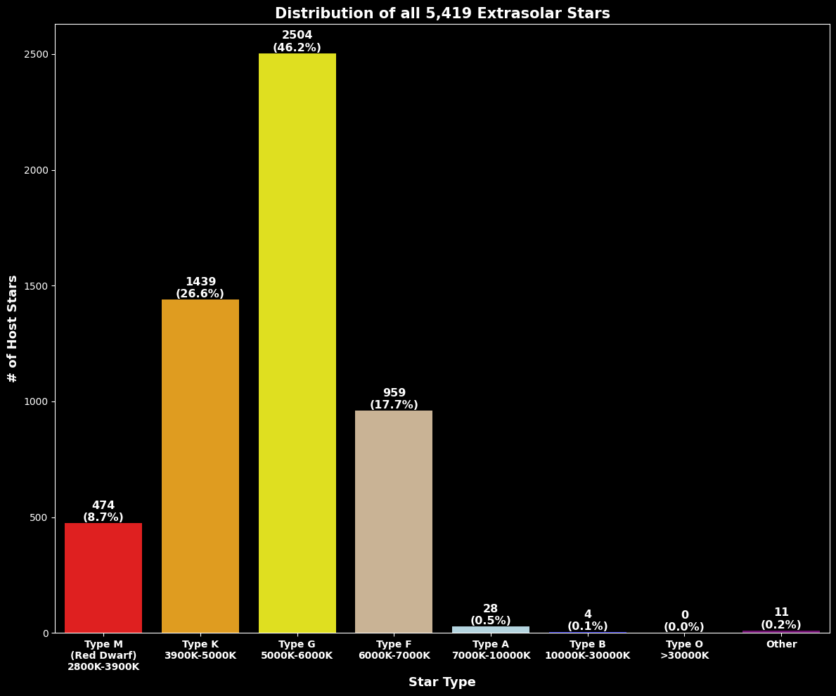

Slide 18
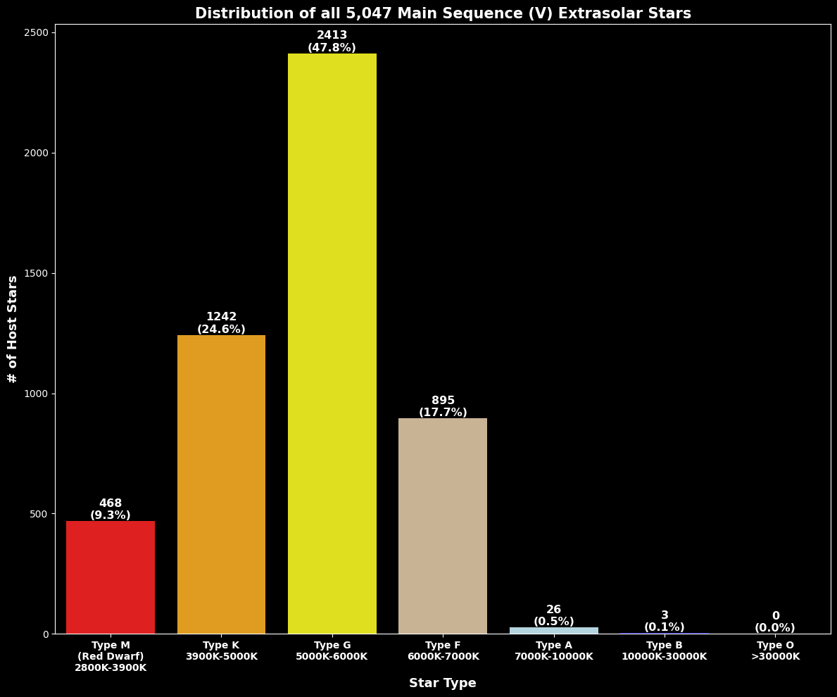

Slide 19
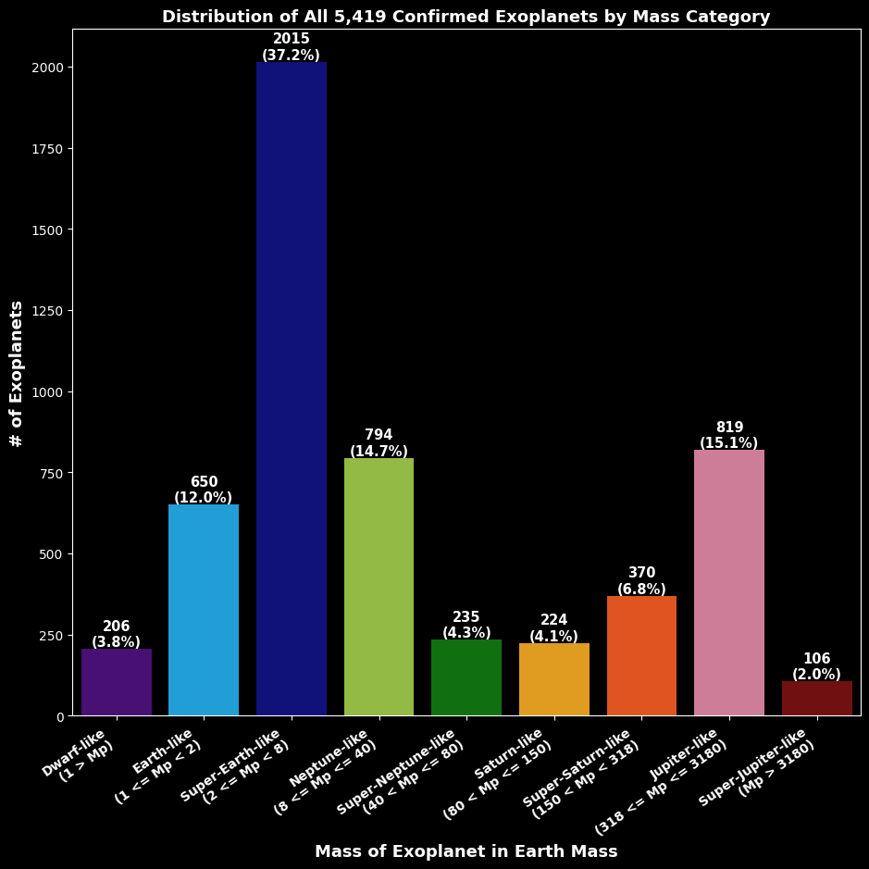

Slide 20
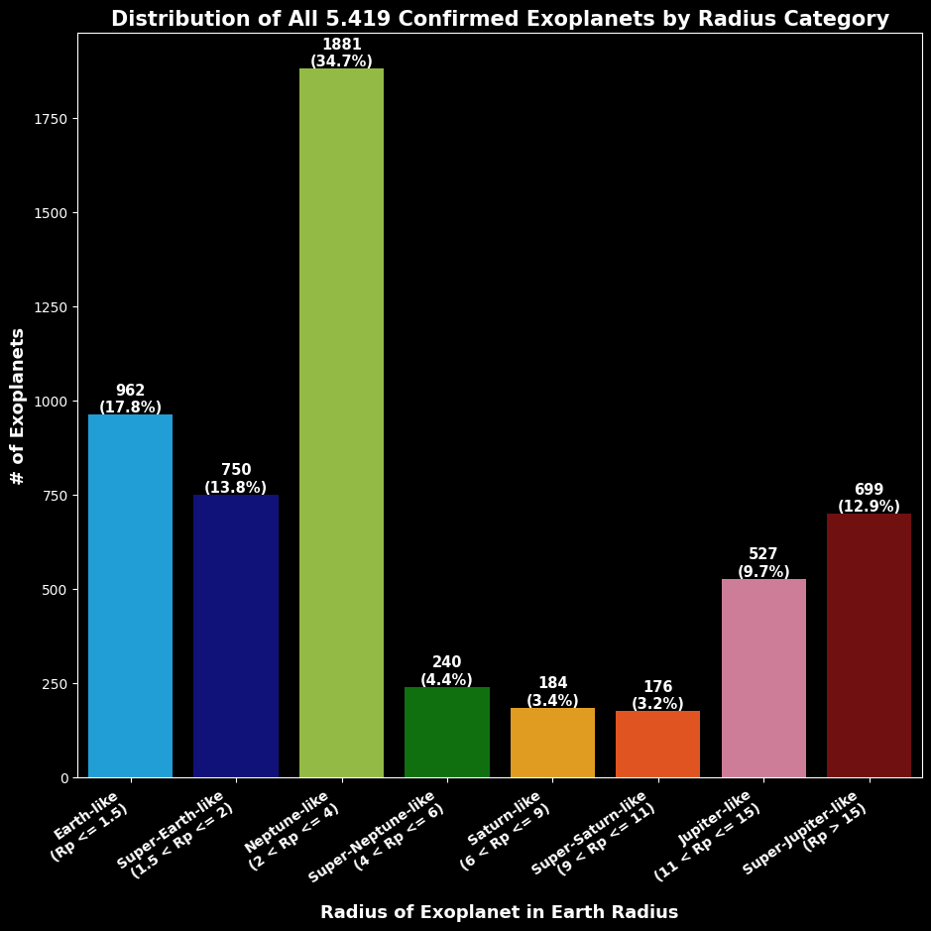

Slide 21
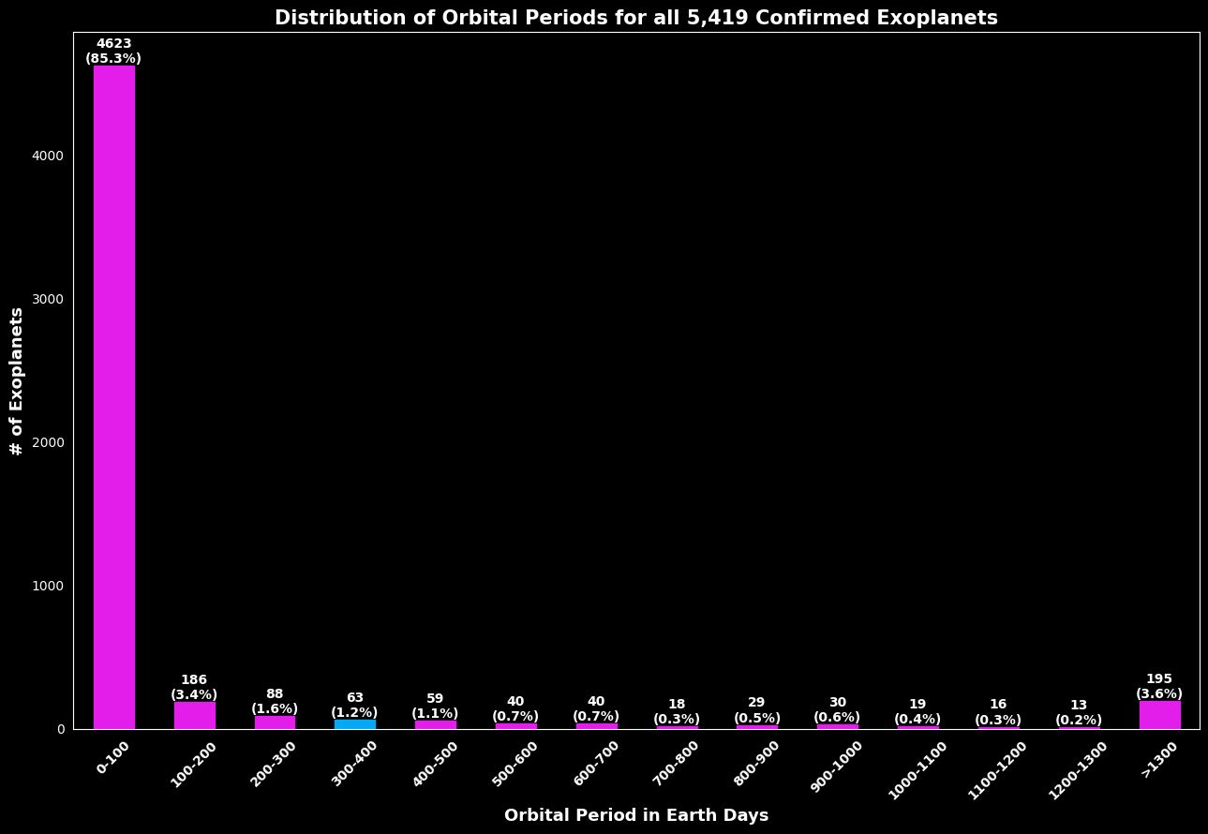

Slide 22
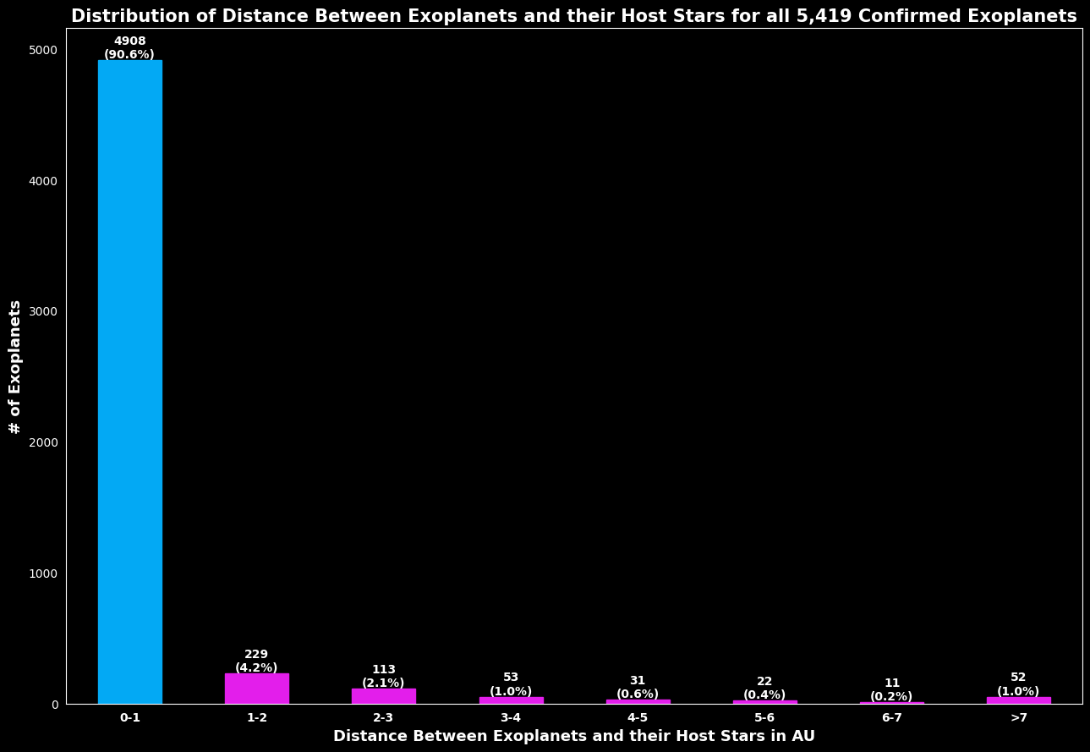

Slide 23
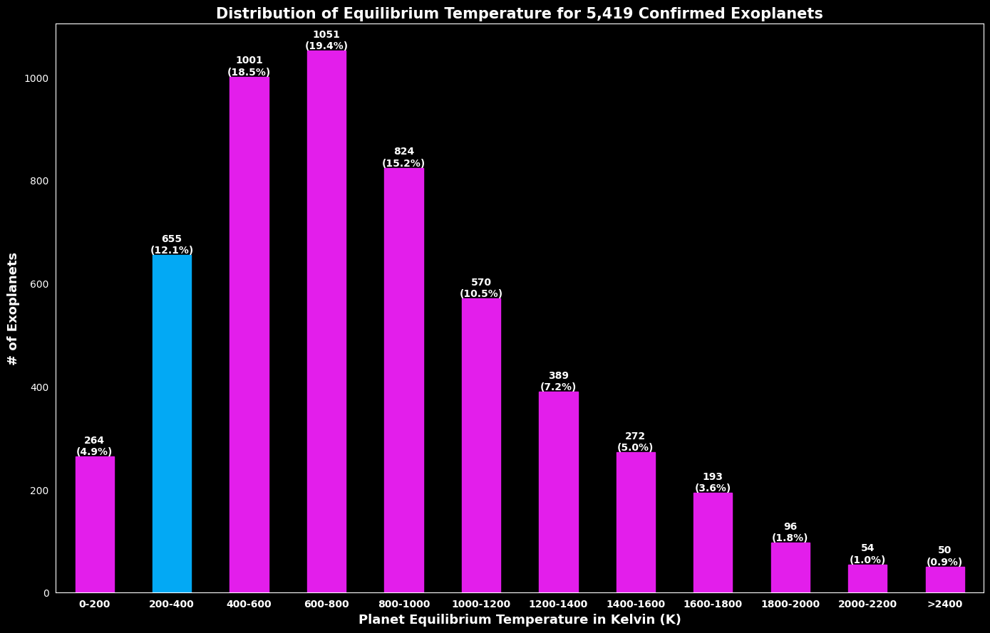

Slide 24
Modeling results

Slide 25
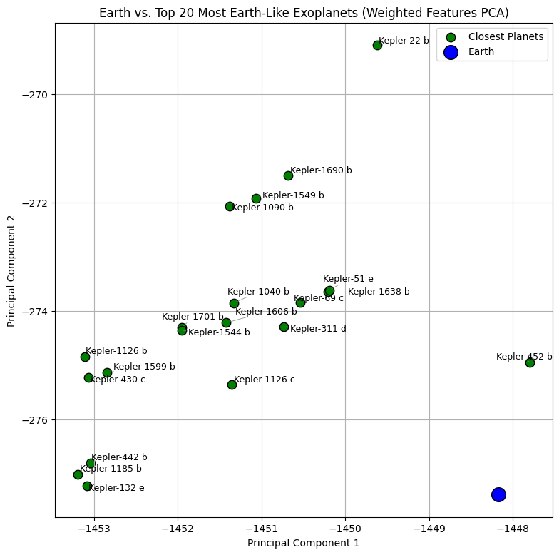
KNN Modeling results
Top 10 Earth-Like Exoplanets KNN Model Comparison
Rank | KNN Model #1 | Manhattan Distance | KNN Model #2 | Euclidean Distance
1 | Kepler-452 b | 10.1463 | Kepler-452 b | 5.2408
2 | Kepler-1638 b | 16.6309 | Kepler-1638 b | 7.1452
3 | Kepler-51 e | 16.7816 | Kepler-51 e | 7.7652
4 | Kepler-1606 b | 19.284 | Kepler-1606 b | 8.2007
5 | Kepler-1701 b | 20.1409 | Kepler-1701 b | 8.466
6 | Kepler-22 b | 20.8885 | Kepler-1126 c | 9.4643
7 | Kepler-1126 c | 22.4542 | Kepler-69 c | 9.9627
8 | Kepler-1549 b | 22.9228 | Kepler-1185 b | 10.35
9 | Kepler-1690 b | 23.2328 | Kepler-442 b | 10.3699
10 | Kepler-69 c | 23.5054 | Kepler-311 d | 10.3847

Slide 26
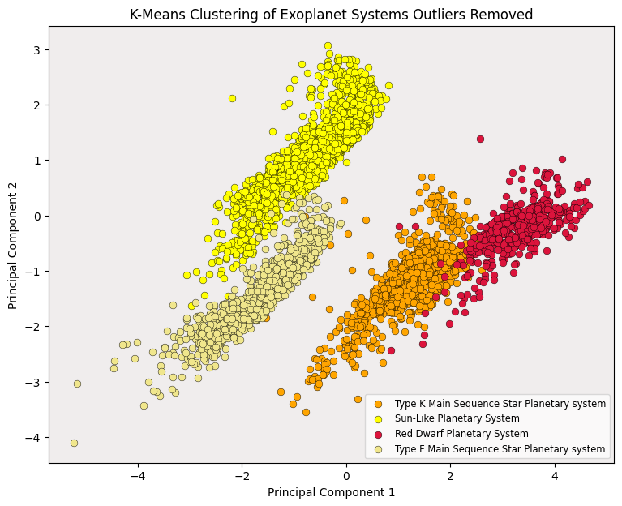
K Means Clustering results
K-Means Clustering Results for Top 5 Earth-Like Exoplanets
Rank | Planet | Cluster_Type (Planetary System)
1 | Kepler-452 b | Sun-Like Planetary System
2 | Kepler-1638 b | Sun-Like Planetary System
3 | Kepler-51 e | Sun-Like Planetary System
4 | Kepler-1606 b | Sun-Like Planetary System
5 | Kepler-1701 b | Sun-Like Planetary System

Slide 27
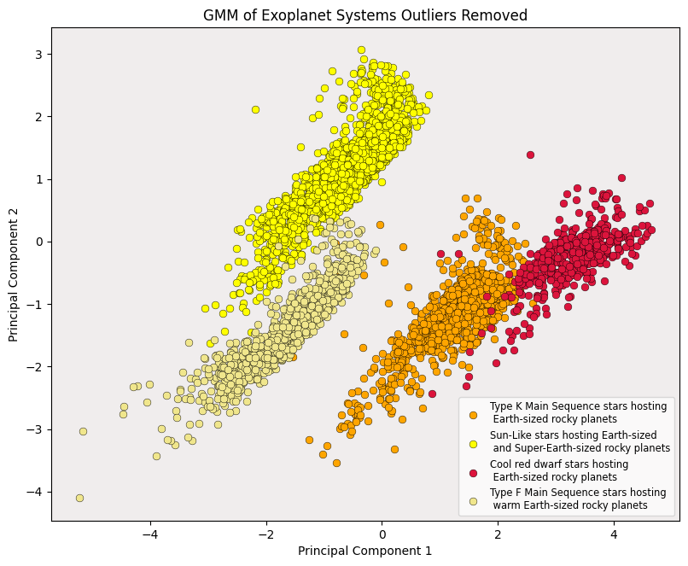
GMM Clustering results
GMM Results for Top 5 Earth-Like Exoplanets
Rank | Planet | Cluster_Type (Planetary System) | Cluster Probability
1 | Kepler-452 b | Sun-Like star hosting Earth-sized and Super-Earth-sized rocky planets | 100%
2 | Kepler-1638 b | Sun-Like star hosting Earth-sized and Super-Earth-sized rocky planets | 100%
3 | Kepler-51 e | Sun-Like star hosting Earth-sized and Super-Earth-sized rocky planets | 100%
4 | Kepler-1606 b | Sun-Like star hosting Earth-sized and Super-Earth-sized rocky planets | 100%
5 | Kepler-1701 b | Sun-Like star hosting Earth-sized and Super-Earth-sized rocky planets | 100%

Slide 28
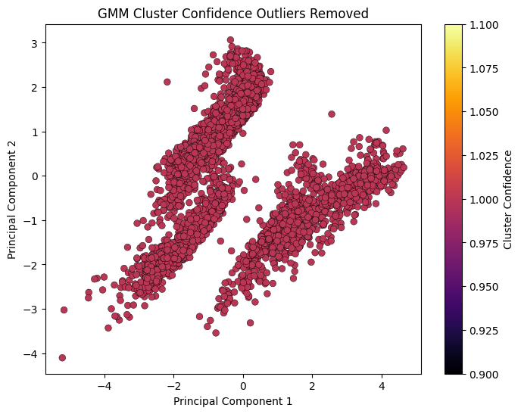
GMM Clustering results

Slide 29
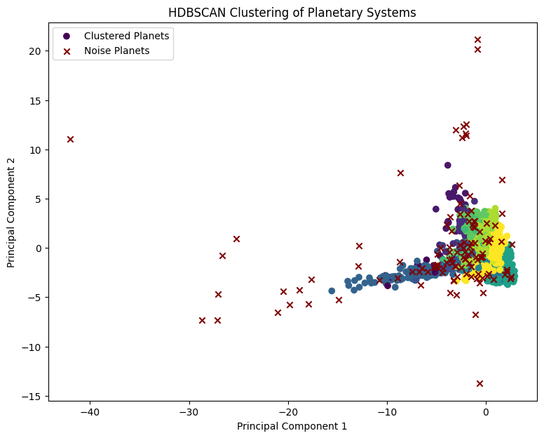

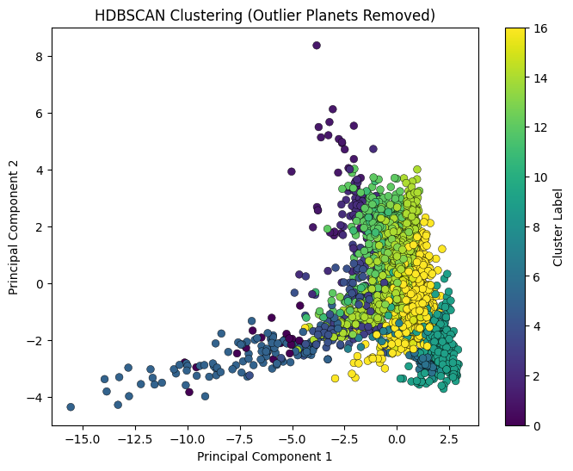
HDBSCAN Clustering results

Slide 30
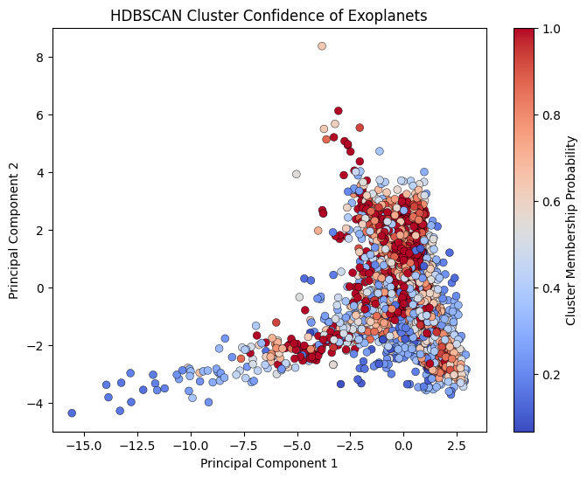
HDBSCAN Clustering results

Slide 31
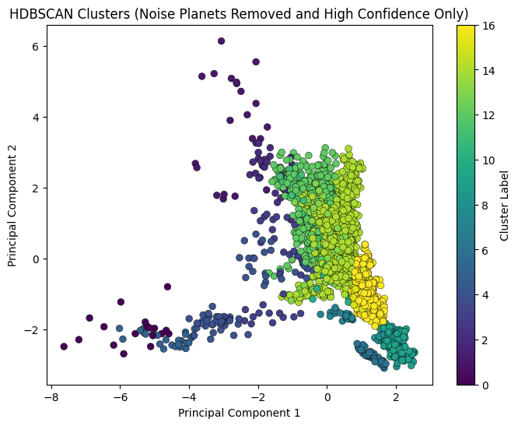
HDBSCAN Clustering results

Slide 32
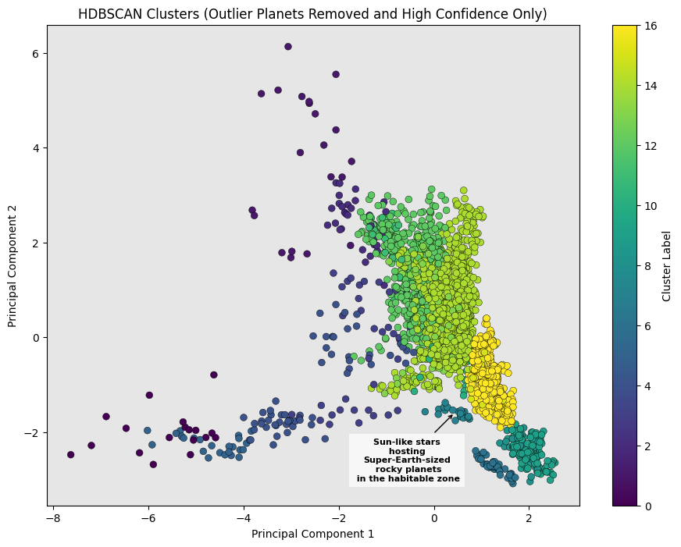
HDBSCAN Clustering results
HDBSCAN Results for Top 5 Earth-Like Exoplanets
Rank | Planet | Cluster_Type (Planetary System) | Cluster Probability
1 | Kepler-452 b | Sun-like stars hosting Super-Earth-sized rocky planets in the habitable zone | 100%
2 | Kepler-1638 b | Sun-like stars hosting Super-Earth-sized rocky planets in the habitable zone | 85.7%
3 | Kepler-51 e | Sun-like stars hosting Super-Earth-sized rocky planets in the habitable zone | 100%
4 | Kepler-1606 b | Sun-like stars hosting Super-Earth-sized rocky planets in the habitable zone | 100%
5 | Kepler-1701 b | Sun-like stars hosting Super-Earth-sized rocky planets in the habitable zone | 100%

Slide 33
Conclusion & Future Work

Slide 34

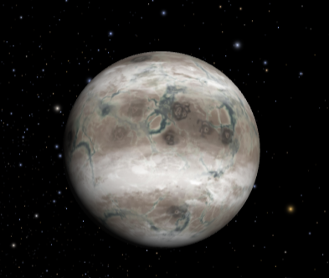
Conclusions
KNN Model #1 (Manhattan Distance) and KNN Model #2 (Euclidean Distance) shows:
The most Earth-Like exoplanet is Kepler-452 b
Followed by Kepler-1638 b, Kepler-51 e, Kepler-1606 b, and Kepler-1701 b
Top 5 Earth-like exoplanets remain consistent using both distance metrics → Top-ranked Earth-Like planets are robust
Mid-ranked Earth-Like exoplanets are sensitive to distance metric choice → Similarity rankings less stable
K-Means Clustering, GMM, and HDBSCAN Shows Agreement:
Consistent results for grouping top 10 Earth-Like exoplanets into planetary systems → validates results
All 3 models successfully identified the natural planetary groupings of all confirmed exoplanets
Groupings show top 5 exoplanets are likely rocky Earth-sized or Super-Earth-sized planets orbiting a Type-G (Sun-Like) star within the Habitable Zone of its star within the Galactic Habitable Zone (Potentially habitable)

Slide 35

Conclusions
K-Means Clustering, GMM, and HDBSCAN Comparison:
K-Means classified planets based on their stellar features. GMM classified planets based on stellar and planetary features. HDBSCAN classified planets based on all key features.
GMM’s high membership probability (>99%) → high confidence in correctly assigning all exoplanets to clusters (including top 10 Earth-Like exoplanets).
HDBSCAN’s high membership probability (85% - 100%) → high confidence in correctly assigning top 10 Earth-Like exoplanets to clusters.
Clustering structure for K-Means and GMM same due to manually removing outlier planets.
Clustering structure for HBDSCAN different since outlier planets automatically removed by model.

Slide 36

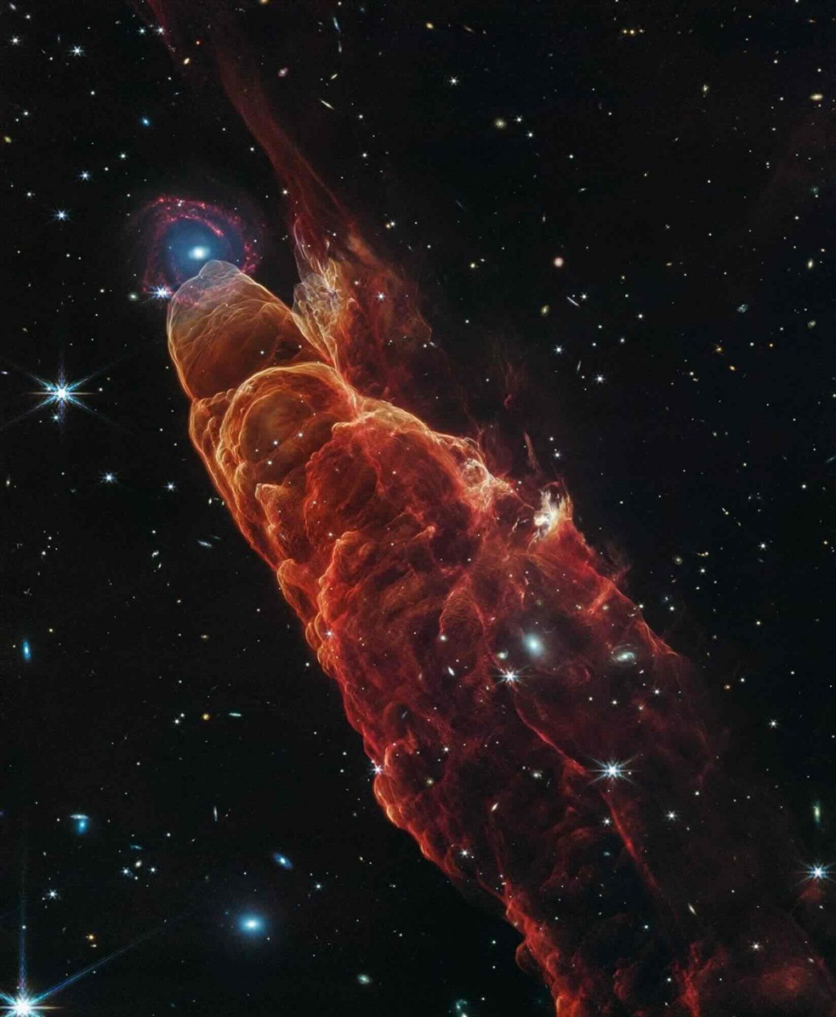
Future work
Expanding study to predict habitability for all exoplanets regardless of their feature similarity to Earth.
Use additional unsupervised learning models
Rank exoplanets by their habitability potential
Analyze the planetary structure of outlier exoplanets which exhibit anomalous features from current known planetary structures.

Slide 37
Thank you!

